Slide 1
HTML Presentation
By- Vishal Sule

Slide 2
Contains
Introduction
HTML document
Tags in HTML
Use of tags
difference between Class and ID selector
What is CSS
How CSS helps HTML
Example-code & output Screenshots

Slide 3
Introduction
HTML is a language for describing web pages.
HTML stands for Hyper Text Markup Language
HTML is not a programming language, it is a markup language
A markup language is a set of markup tags
HTML uses markup tags to describe web pages

Slide 4
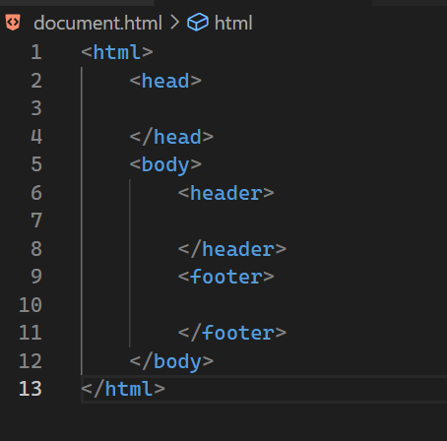
HTML document
<html></html>
<head></head>
<body></body>
<header></header>
<footer></footer>

Slide 5
Tags in HTML
<html>
<head>
<title>
<body>
<h1> to <h6>
<p>
<br>
<hr>

Slide 6
Use of tags
<html> - Defines an HTML document
<head>- Contains metadata/information for the document
<title> - Defines a title for the document
<body>- Defines the document's body
<h1> to <h6>- Defines HTML headings
<p>- Defines a paragraph
<br>- Inserts a single-line break
<hr>- Defines a thematic change in the content

Slide 7
difference between Class and ID selector
ID selector
The ID selector matches an element based on the value of its id attribute. For the element to be selected, its ID attribute must exactly match the value given in the selector. The # symbol and the id of the HTML element name are used to select the desired element.
Class selector
The class selector selects elements with a specific class attribute. It matches all the HTML elements
based on the contents of their class attribute. The”.” symbol, along with the class name, is used to select the desired class.

Slide 8
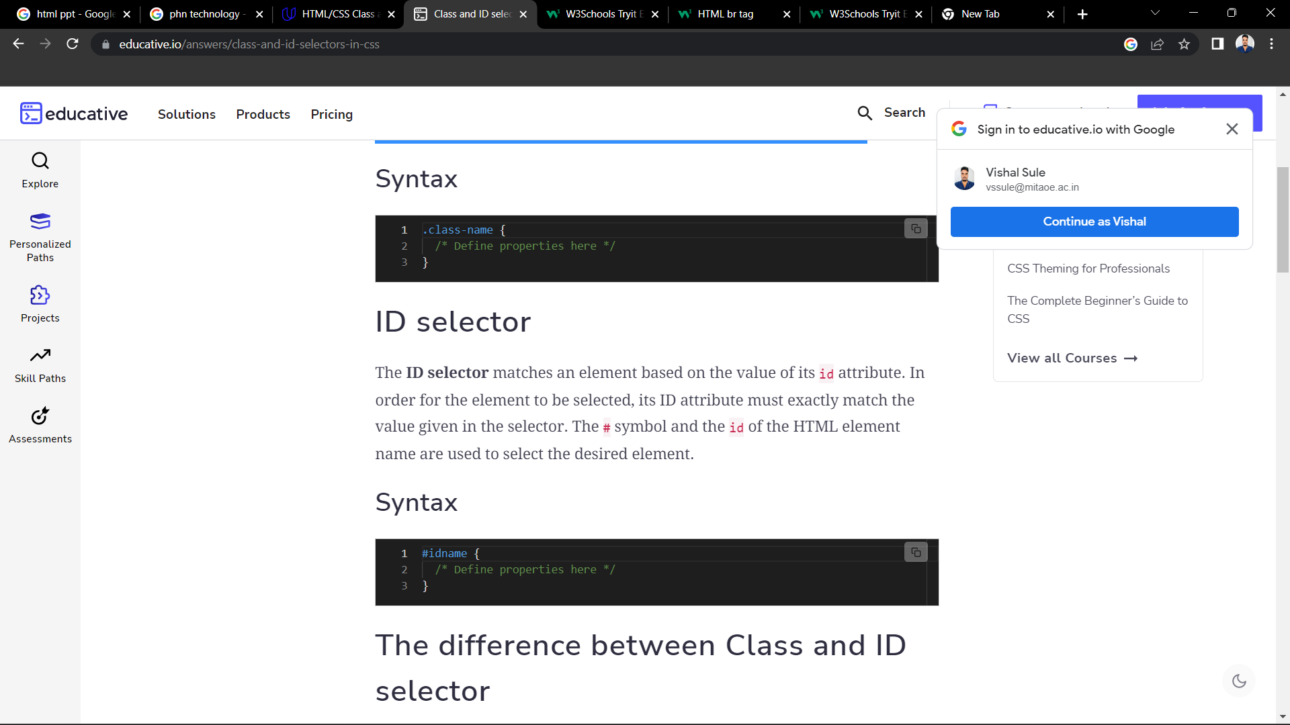
Syntax

Slide 9
What is CSS
CSS stands for Cascading Style Sheets
CSS describes how HTML elements are to be displayed on screen, paper, or in other media
CSS saves a lot of work. It can control the layout of multiple web pages all at once
External stylesheets are stored in CSS files

Slide 10
How CSS helps HTML
With CSS, you can control the color, font, size of text, the spacing between elements, how elements are positioned and laid out, what background images or background colors are to be used, different displays for different devices and screen sizes, and much more!

Slide 11
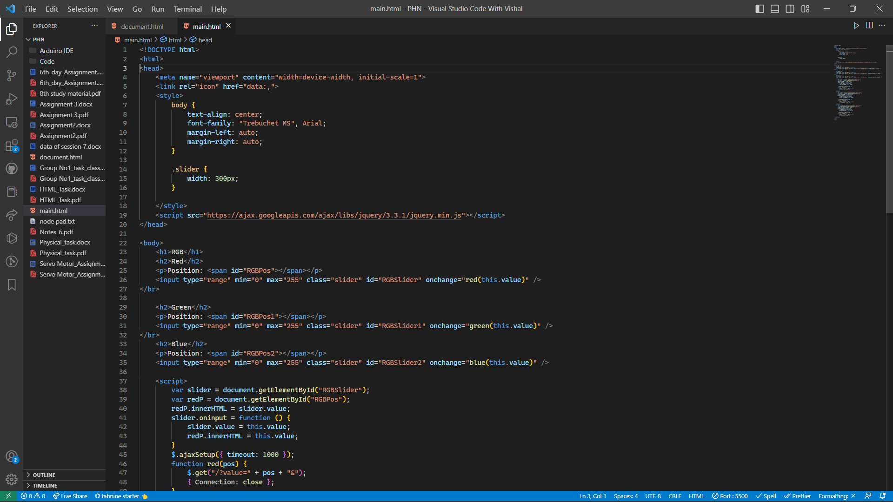
Example-Code

Slide 12
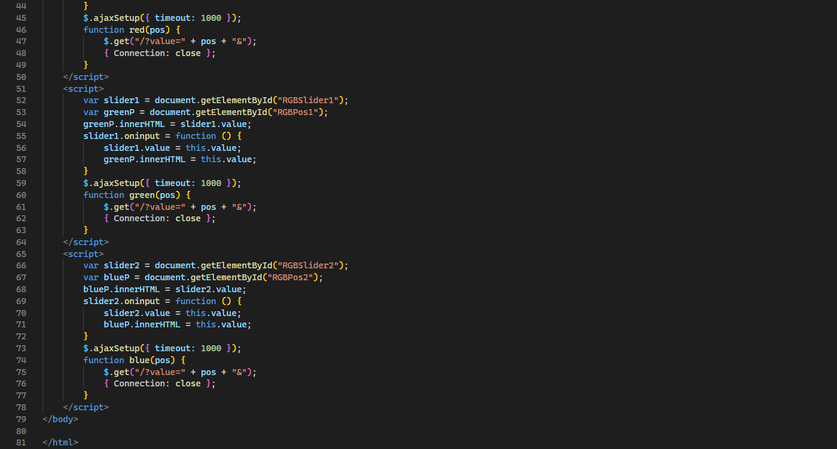
Example-Code

Slide 13
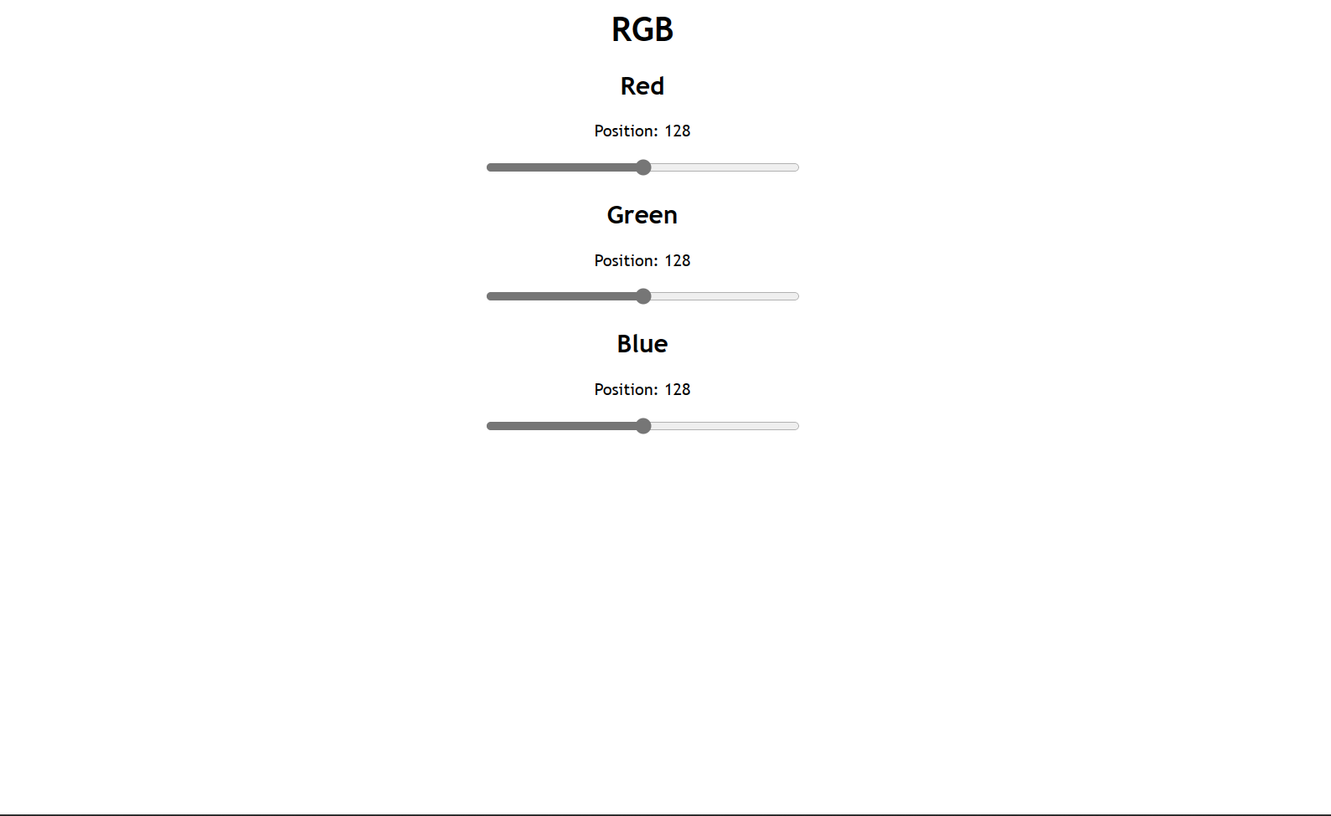
Example-Output

Slide 14
Thank You

